Slide 1
DeepTyper for Python
Travis Chambers

Slide 2

Python Types
PEP 3107 – Function Annotations – Dec 2006
PEP 484 – Type Hints – Sept 2014
PEP 526 – Variable Annotations – Aug 2016
Typing officially supported with Python 3.6 (released Dec 23, 2016)

Slide 3
Why Typing?
15% of bugs in JavaScript could be prevented by type annotations
Lack of types:
Hard to understand APIs
Difficult to read, maintain, and document
Poor IDE support
Notes:
Gao – To Type or Not to Type: On the Effectiveness of Static Typing for JavaScript 2017 IEEE
How can an IDE suggest autocompletions if it doesn’t know the type? Just suggest all variables in a file?

Slide 4
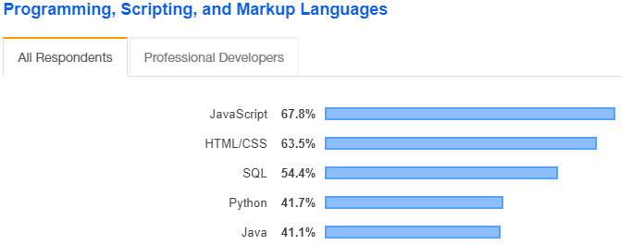
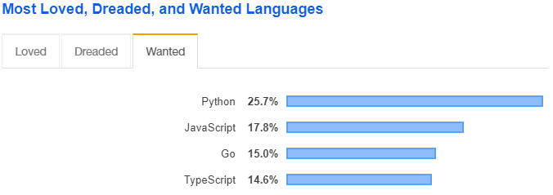
Dynamically Typed Languages
JavaScript -> TypeScript
Python -> typing module
https://insights.stackoverflow.com/survey/2019#technology
Notes:
https://docs.python.org/3/library/typing.html
https://www.python.org/dev/peps/pep-0484/
https://www.python.org/dev/peps/pep-0526/

Slide 5
Python Typing
Not that popular
If used poorly, can decrease readability
However, if used well….

Slide 6
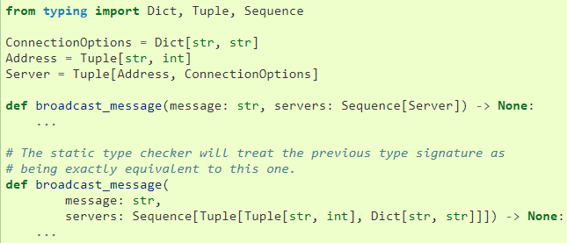
Type Aliases

Slide 7
Typing Examples
isort - https://github.com/timothycrosley/isort
Tale - https://github.com/irmen/Tale
FastAPI - https://github.com/tiangolo/fastapi

Slide 8
Generated Code Corpus
No existing corpus of python code using type hints
Mined GitHub manually
Total typed: 2064
Total typed lines of code: 1,068,993

Slide 9
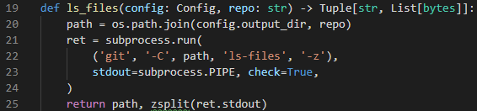
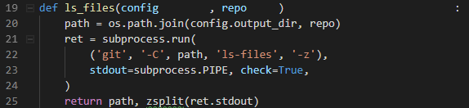
Stripped Type Hints

Slide 10
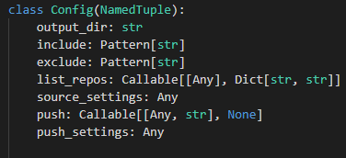
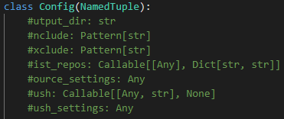
Challenges
Type aliases make it difficult to tokenize/predict accurately
Class variable annotations get completely stripped, since without the annotation it’s invalid code
Notes:
Since a type alias actually gets stripped out, since it is a type annotation itself. But then, how can we predict a type annotation might have actually been an alias?

